Slide 1
Golgi Bodies
Nandakumar S
Asst Professor
PG Deapartment of Zoology

Slide 2
Aggregations of membrane-bound spaces
Serve as centres of cellular secretion
Concerned with concentration, chemical modification & packaging of synthetic products as secretory granules or droplets
First discovered by Camillo Golgi (1898)
Located between nucleus & apical pole in secretory cells
Circum-nuclear position in nerve cells
Most cells – only a single set
Invertebrate cells, nerve cells, liver cells – multiple sets (called dictyosomes)
Salivary gland cells - numerous

Slide 3
Morphology
Membrane-bound spaces
Three kinds
Lamellae (core units)
Vesicles (around lamellae as clusters)
Vacuoles (around lamellae as clusters)

Slide 4
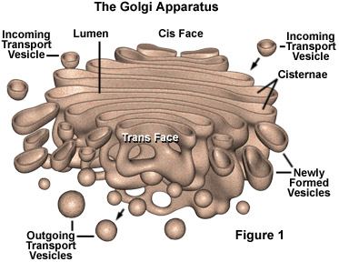

Slide 5
Lamellae
Flattened sacs in parallel stacks called golgiosomes
Interlamellar space filled with granular material
Lamellar membranes are always in equilibrium
They form by getting budded off from SER
At the same time lost for formation of secretory vesicles
Each lamella has a convex outer side (entry face or cis face) &
a concave inner face (exit face or trans face)
Cis face receives vesicles from ER; trans face gives out secretory vesicles
Both face associated with network of tubules called cis Golgi network & trans Golgi network
Lamellar stack has 3 kinds of sacs
Cis sacs (towards cis face of stack)
Trans sacs (towards inner face of stack)
Medial sacs (middle of stack)
Cis sacs – phosphorylation of mannose molecules of glycoproteins for lysosomes (this formation gives signal to direct proteins to lysosomes)
Medial sacs – removal of mannose molecules & addition of acetyl glucosamine
Trans sacs- addition of galactose & sialic acid to glycoproteins
Transport of glycoproteins from cis-to-medial-to-trans sacs is effected by the vesicles which bud from one sac and then fuse with next sac

Slide 6
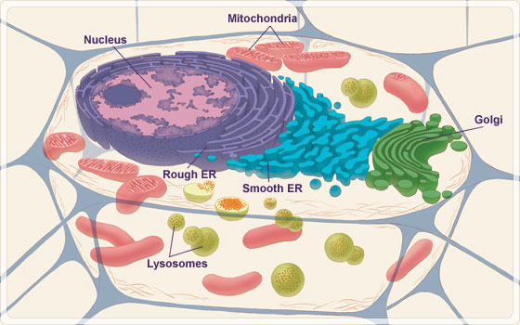

Slide 7
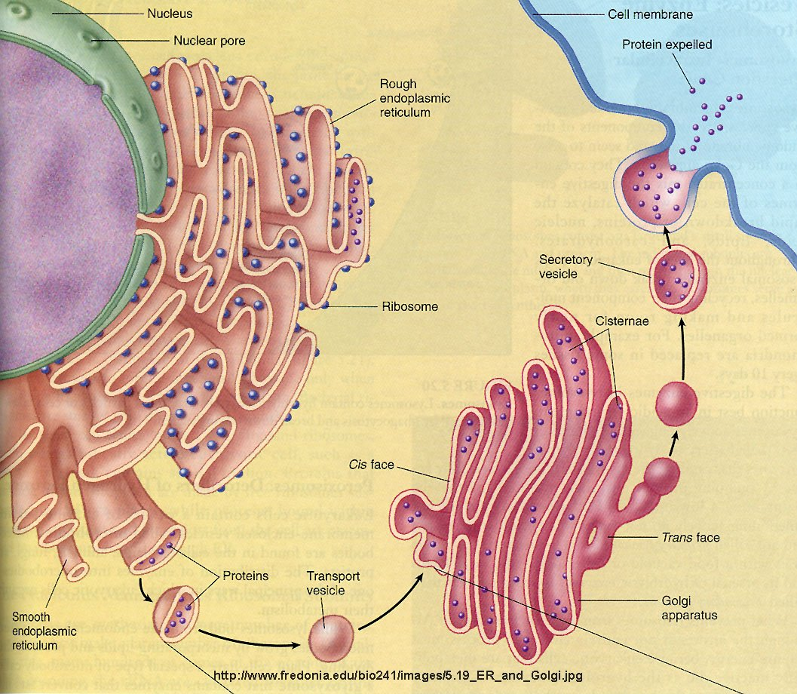

Slide 8
Between cis face and RER- membrane bound bodies, called transition vesicles or transition tubules
They converge upon the lamellae
They are originated from RER and form new lamellae
This compensates the lose of lamellae at trans face

Slide 9
Vesicles
Large, scattered sacs
Filled with granular material
Two types
Smooth-surfaced vesicle
Rough-surfaced vesicle
Zone of exclusion
Area around golgi bodies, where glycogen, ribosomes and mitochondria are absent

Slide 10
Chemical composition
Chemical composition change from time to time
Fluid mosaic model
Phospholipids, proteins (high content)
Cholesterol, carotenoids, fatty acids, triglycerides, mucopolysaccharides, vit. C (low content)
Rich in enzymes
Mainly thiamine pyrophosphatases & glycosyl tranferases (Transfer oligosaccharides to proteins & lipids to synthesize glycoproteins & glycolipids)
ADPase, ATPase, phospholipase, transferases, lysosomal enzymes

Slide 11
Biogenesis
Components of Golgi complex are constantly formed, changed, broken down and re-formed
Three hypothesis
De novo (as new buds)
Arise from pre-existing membrane (from PM, ER & nuclear membrane)
Golgi lamellae from SER

Slide 12
Functions
Secretory centres of the cell
Serve as intracellular compartment for chemical modification & transformation of substances synthesised elsewhere
Serve for differentiation and rapid turn over of cellular membranes
Synthesis of mucopolysaccharides, glycoproteins, glycolipids by glycosylation (using glycosyl transferases)
Cellular secretion of export proteins, intracellular enzymes, hormones, antibodies, yolk granules, lipid droplets, etc
Secretion of mucus, milk protein, thyroxine compounds, etc
Formation & packaging of zymogen, melanin granules, etc
Formation of microbodies, primary lysosomes
Formation of acrosome in developing animal sperms
Formation of protective coating in developing oocytes
Removal & recycling of excess membranes
Formation, packaging and transport of cell wall polysaccharides

